Slide 1


De-Industrialisation Concept in Resource Rich Countries
Sarvar Gurbanov, Ph.D.
Fulbright Visiting Scholar
University of Southern California
from Qafqaz University
Baku / Azerbaijan

Slide 2


Slide 3
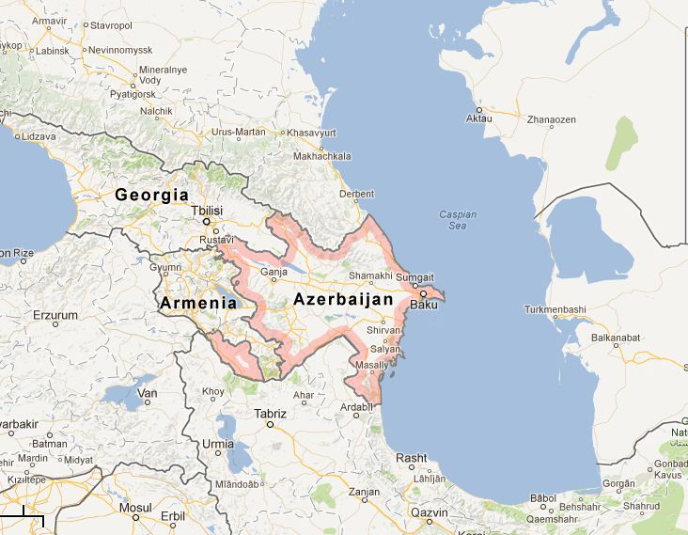
Caspian Lake & Sea ?

Slide 4
Dutch Disease Term
27 November 1977, The Economist
Core Model :
W.Max Corden &J. Peter Neary. (1982).
“Booming sector and de-industrialization in a
small open economy”. The economic journal, 92 (368): 825-848.

Slide 5
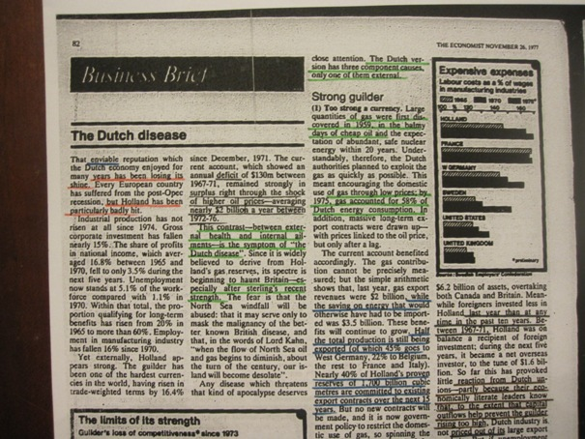

Slide 6
What Happened in Holland?
Gas Discoveries in 1959
Alternative energy sources will emerge soon
Since December 1971 to 1977, Guilder rised by 16.4 %
The current account
Between 1967 – 1971 annual deficit $130 m
Surplus right through the shock of higher oil prices
1972 – 1976 average surplus $2 billion
External Health – Internal Ailment

Slide 7
Dutch Experience
Strong Guilder
2. High Costs, more rapidly growing unit wage costs
3. Use of gas revenues : Spent, not invested
e.g. Government spending has gone on transfer payments, unemployment benefit, etc.

Slide 8
Dutch Disease Symptoms
Resource Movement Effect
Spending Effect

Slide 9
Resource Movement Effect
Direct
De-Industrialization or De-agriculturization
Capital and labor are drawn away from agric and manuf.
Resource Boom

Slide 10
Spending Effect
EXCESS DEMAND ON
NON-TRADABLES
REEL EXCHANGE RATE APPRECIATION
INDIRECT DE-INDUSTRIALISATION
RESOURCE BOOM

Slide 11
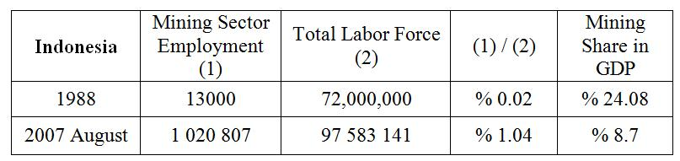
Enclave Nature of Abudant Resources for Indonesia

Slide 12
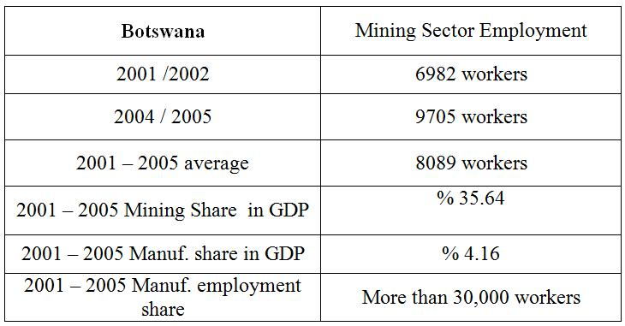
Enclave Nature of Abudant Resources for Botswana

Slide 13
Dutch disease / DE – Industrialisation is not only about natural resources
Spain , tourism
Egypt, Turkey, Worker`s Remittances,
Colombia, Coffee
Uganda, External Aid
Paraguay, energy dam construction
and so on…

Slide 14
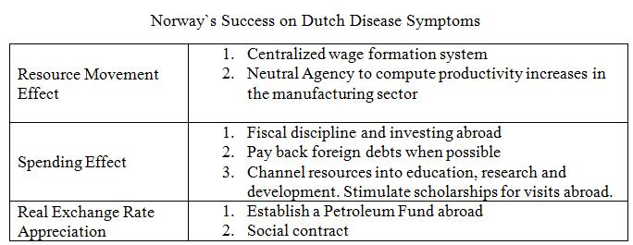
Norway`s Success on Dutch Disease

Slide 15
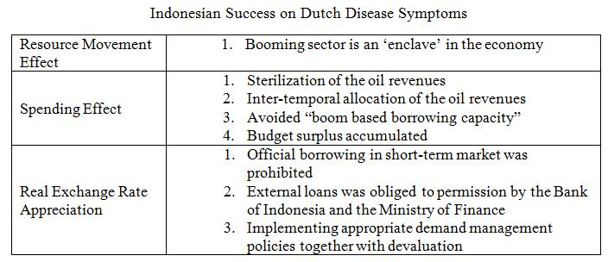
Indonesia`s Success

Slide 16
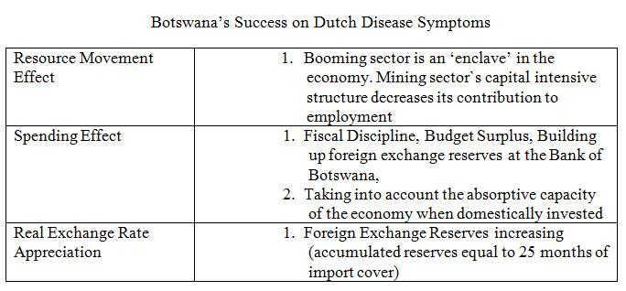
Botswana`s Success

Slide 17
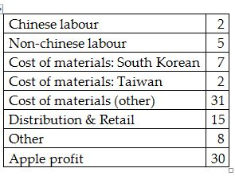
Why is Dutch Disease important?
De-industrialisation, shrinking manufacturing sector , multiplier effect on job creation:
Distribution of value for an Apple iPad (2010, % of total)

Slide 18
Wise management of windfall gains
In 1975, on September 29, Time Magazine published an article, which implicitly recommended Norway to review the decision of North Sea oil drilling investment. For Time magazine, only for the inhospitable geography, Norway were supposed to stay away from oil and gas extraction:
“Through 1980, costs could reach $35 billion for Britain and Norway alone, or $11 billion more than the U.S. spent to land a man on the moon. Major U.S. oil companies, including Chevron, Amoco, Exxon, Texaco and others are drilling in the North Sea. But rigs are now in surplus, and the pace of exploration is expected to slow. One Norwegian oilman says flatly that ‘the North Sea is not a bonanza’”

Slide 19
Norway Oil Fund…
On the latest report of the Norway`s Government Pension Fund Global, an institution, which is established for accumulating oil revenues, fund`s market value is stated as 878 billion dollars.
Stay away too much dependence to the oil sector…
The fund held 59.6 percent in equities, 40.1 percent in fixed income and 0.3 percent in real estate
One barrel of oil contains 6,12 Gj (gigajoule) energy, that is it has real value. The stocks and bonds which Norway oil fund has already invested its billions they hold their value as long as system of financial market continue to exist.

Slide 20
Russian Oil Fund
In 2008, while the total sum of assets of Russian reserve funds (Reserve Fund 125 billion dollars, Fund of National Well-Being 32 billion dollars) was 157 billion dollars, deputy US Treasury secretary Robert M. Kimmitt wrote in Foriegn Affairs that sovereign wealth funds should be welcomed to the United States. In his opinion he particularly noted the risks:
"including the possibility that foreign intelligence agencies would provide nonpublic information to the managers of such funds to assist their investing decisions".
Today in these two funds, amount of total assets have reached to the 230 billion dollars.
http://www.swfinstitute.org/fund-rankings/

Slide 21
De – industrialisation will take place in two directions
RME > SE,
non-tradable sectors shrink down
SE > RME ,
non –tradable sector expands
In both situation, de-industrialisation takes place
direct / indirect

Slide 22
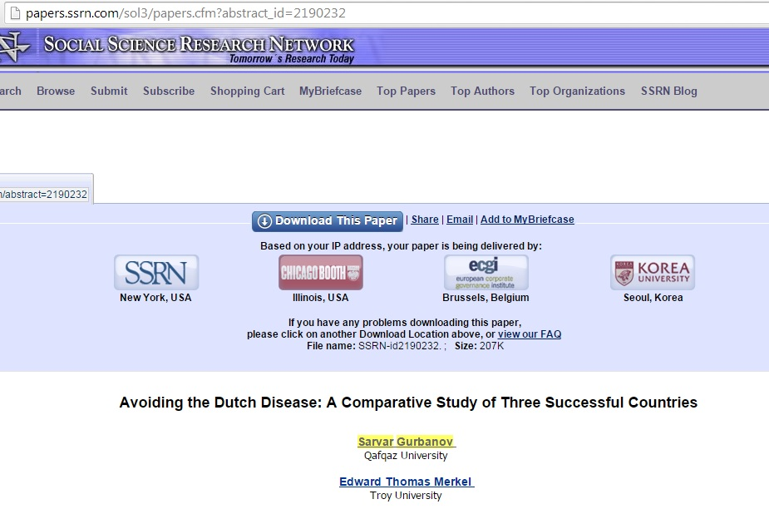

Slide 23
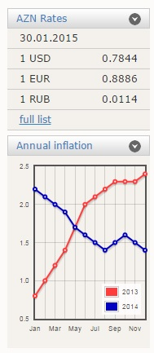
National currency… Manat …

Slide 24
For the sake of brainstorming…
What about Dutch Disease in German Economy ?

Slide 25
Case of Azerbaijan

Slide 26
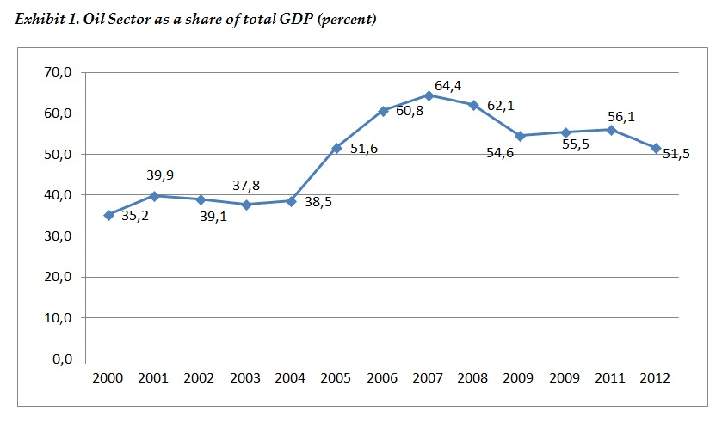

Slide 27
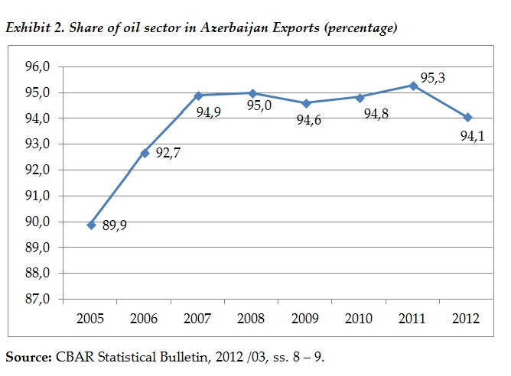

Slide 28
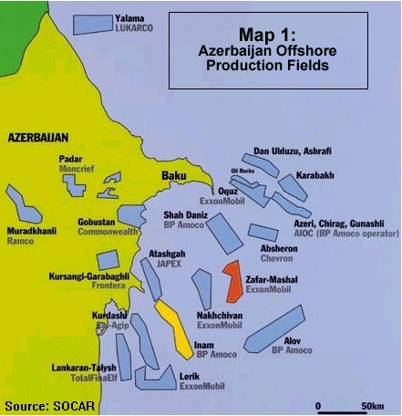

Slide 29
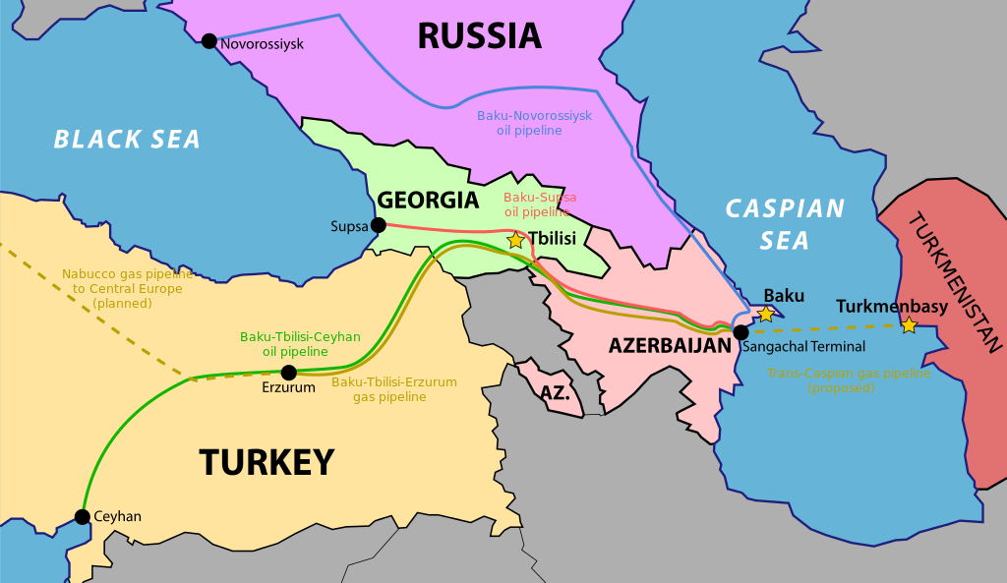

Slide 30
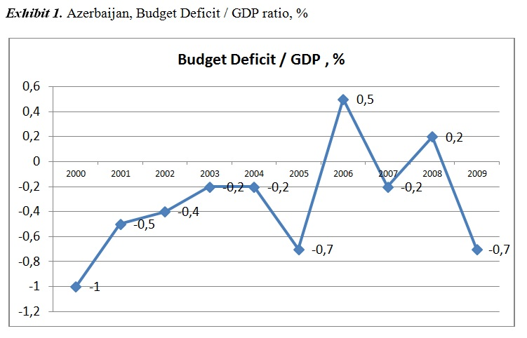

Slide 31
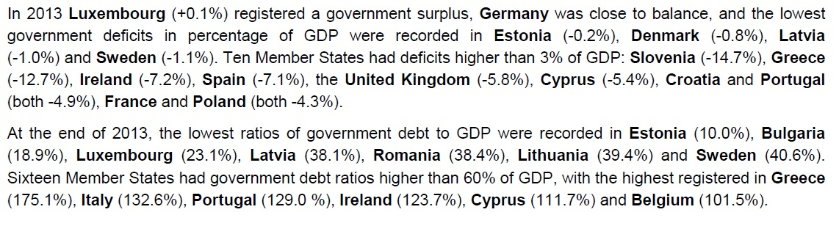

Slide 32
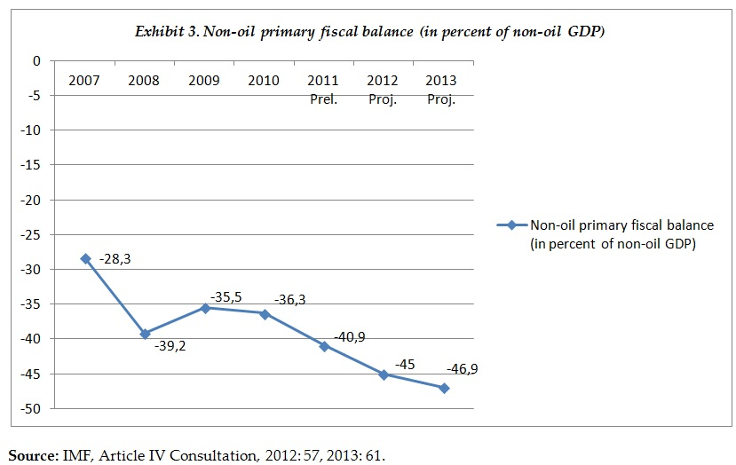

Slide 33
Primary Institutions
PSA s
State Oil Fund

Slide 34
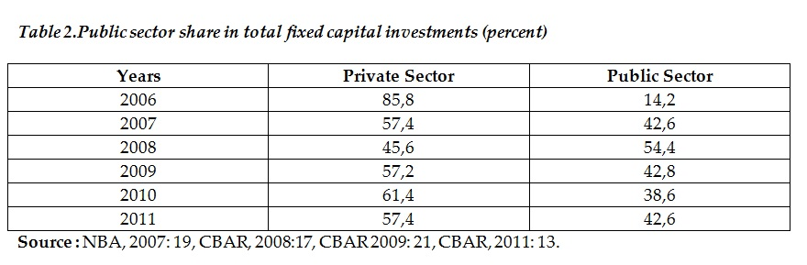

Slide 35
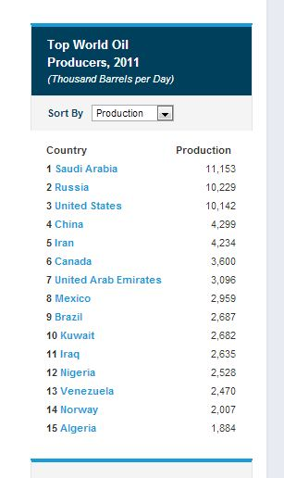
Kazakhstan Case…

Slide 36
Kashagan Offshore Oilfield Project (38 billion barrels)
Discovered in July 2000, Kashagan has been described as the largest field found in the past 30 years, the largest outside of the Middle East, with a projected output close to that of the Ghawar field in Saudi Arabia.
The field is being developed by a group of partners including Shell, Exxon Mobil, Total, ConocoPhillips, Kazakh state-run oil company KazMunaiGas, INPEX and AgipKCO (Eni). Eni is responsible for phase I of the field's development, while Shell is responsible for production operations.

Slide 37
Kashagan Offshore Oilfield Project (38 billion barrels)
The project, however, suffered several delays and costs increased from $57bn to $187bn. The cost estimate for phase I was increased to $46bn in January 2012, from the original estimate of $24bn.
A new joint operating company North Caspian Operating Company (NCOC) became the operator of the field. In January 2010 NCOC announced the budget allocated for the development of the Kashagan field had been reduced to $7bn from the earlier $10bn.
Up to 2010, NCOC spent $28bn in developing the field. First production from the field is now expected in June 2013 (13 years, only first phase).

Slide 38
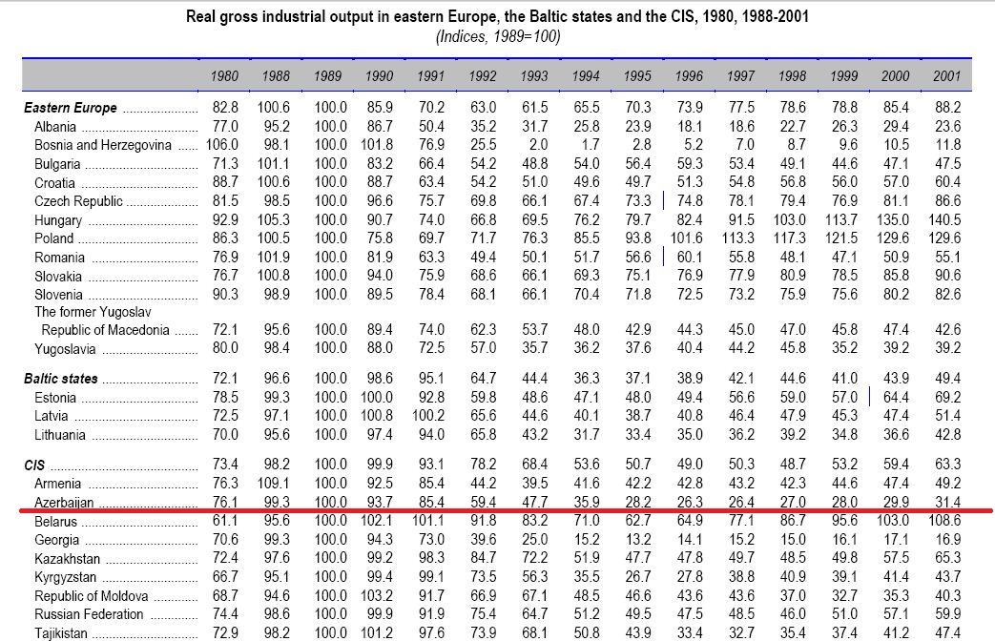
Azerbaijan Case: Transition + War

Slide 39
Importance of Manufacturing
provides above-average-paying jobs,
is the source of good jobs for non-college-educated workers
for generations, manufacturing has built up middle class,
provides jobs which are more likely to be full-time jobs, and have good benefits for workers
Multiplier effect on job creation

Slide 40
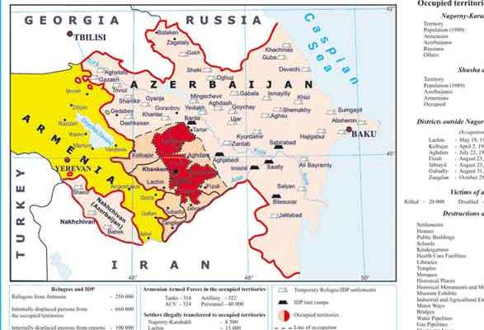

Slide 41
Contract of Century , Production Sharing Agreements (PSAs)
On September 18, 2002 at Sangachal the construction of the Baku-Tbilisi-Ceyhan pipeline began and completed in 2005. Nearly $ 4 billion was spent on the construction of the pipeline.
Shareholders of BTC Co. established for the construction and operation of the pipeline are BP (30.1%), SOCAR (25%), Chevron (8.9%), Statoil (8,71%), TPAO (6,53%), ENI (5%), Total (5% ), Itochu (3.4%), INPEX (2.5%), ConocoPhillips (2.5%) and Amerada Hess (2.36%) companies.

Slide 42
Contract of Century , Production Sharing Agreements (PSAs)
It is expected to transport 50 million tons of Azerbaijani oil via BTC pipeline.
From the date of commissioning of the BTC till May 30, 2012 185,9 million tons of Azerbaijani oil was delivered to world markets from the port of Ceyhan.

Slide 43
External debt in Azerbaijan Case…
Relatively unimportant resource movement effect
Management of Spending Effect is very crucial
Avoiding debt overhang, boom based borrowing capacity and using oil revenues as collateral for external borrowing
Cushion: SOFAZ, State Oil Fund of Azerbaijan
Production sharing agreements

Slide 44
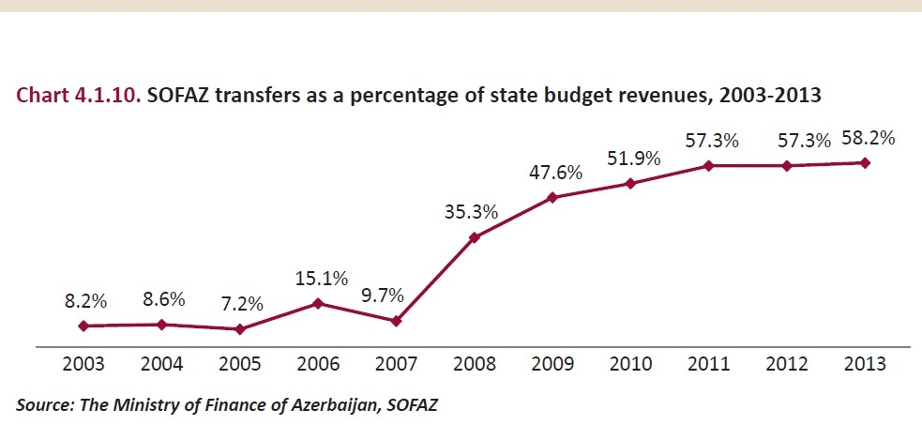

Slide 45
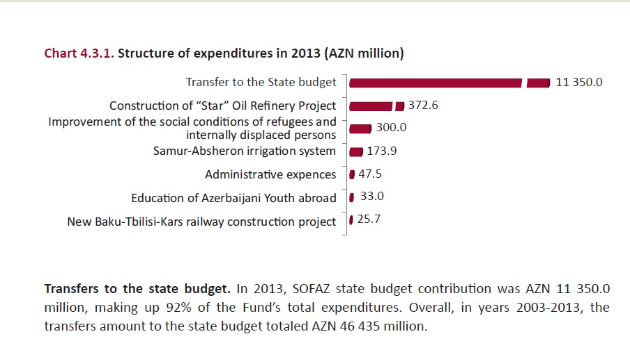
Oil Fund Expenditures

Slide 46
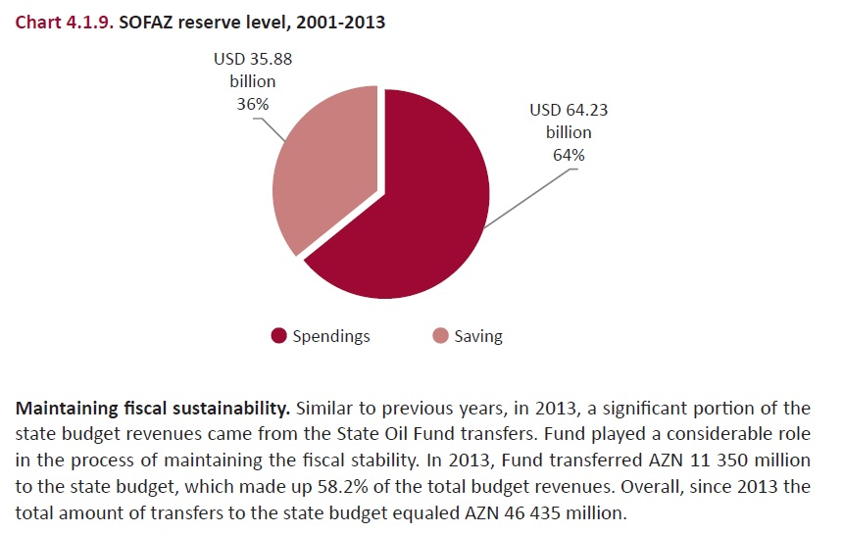

Slide 47
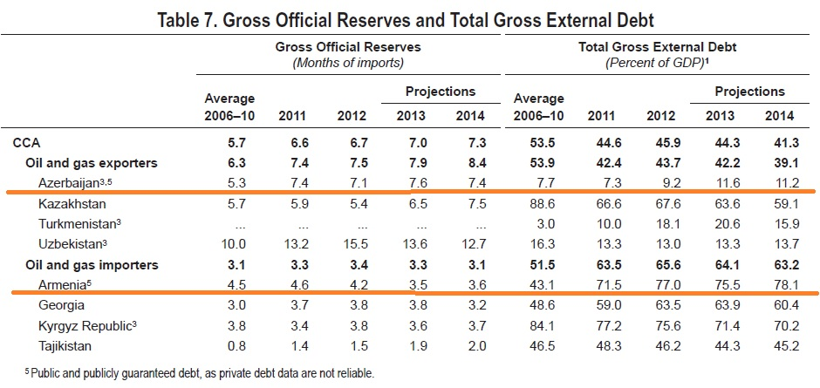

Slide 48
Extractive Industries Transparency Initiative (EITI)
Azerbaijan joined the EITI in 2002, and became a pilot country in July 2004.
The EITI only relates to how revenues are collected.
2014, Industry Year,
2015 – 2020 Industrial Development Plan

Slide 49
Non oil diversification
Azerbaijan 2020 - Development Concept: in this critical development document, it is stated that, Azerbaijan plans to reach the goal of 1000 USD per capita non-oil export. By the end of 2012, Azerbaijan total non-oil exports equal to 1,9 billion dollars (CBAR, 5/2013)
With the current 9,3 million citizens, per-capita non-oil export is about 208 USD per capita. (five fold increase )

Slide 50
Q & A session ?!
Thank You for your attention !
Dr. Sarvar Gurbanov
sg_112@usc.edu
squrbanov@qu.edu.az

Slide 51
Appendix

Slide 52
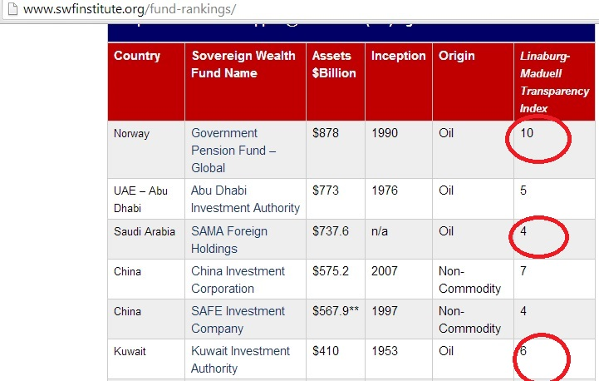

Slide 53
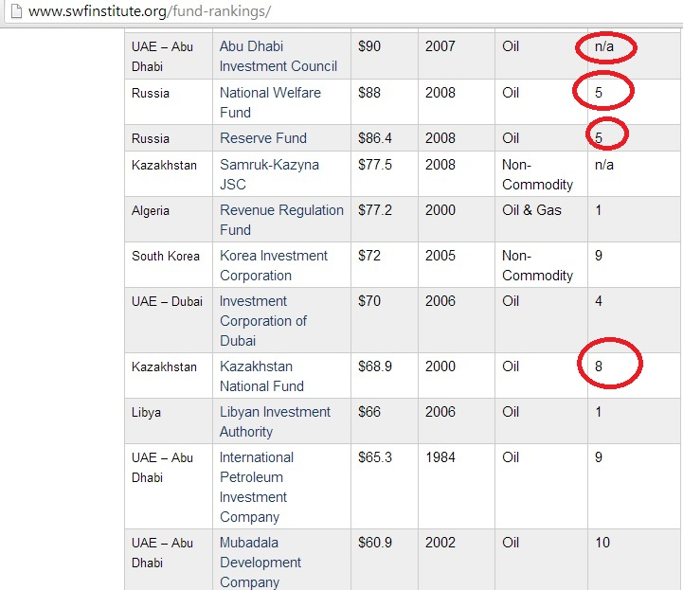

Slide 54
